Slide 1

The House Market in King County, USA
Training ML-Models to predict the price of a house
Sebastian Brockschmidt

Slide 2
Table of content
Data
Preparing the data
Feature Engineering
Feature Selecting
Training/Testing different models
Conclusion

Slide 3
Data
The dataset comprises one-year data (from May 2014 to May 2015) of house sale prices across King County, including Seattle. It features 21 different columns, providing a comprehensive overview of the real estate market.

Slide 4
Preparing the data
The dataset did not contain any NaNs, Null-Values, empty spaces or duplicates.

Slide 5
Feature Engineering
All features are numericals, except the date.
Original format: 20141013T000000 (Object)
New format: 20141013 (Integer)

Slide 6
Feature Selection
Every feature of the dataset seemed relevant for predicting the house price, except the ‘id’ column.
The ‘id’ column was set as the index.

Slide 7
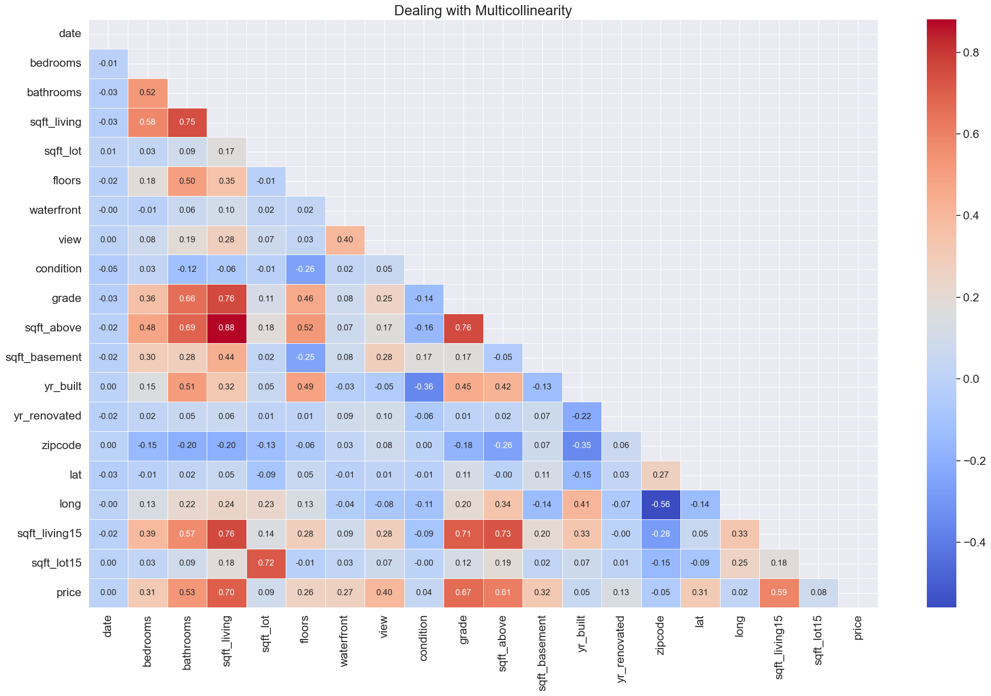
Feature Selection
sqft_above and sqt_living
are highly correlated (0.88).
sqft_above was dropped,
since sqt_living has a
higher correlation with our
target.

Slide 8
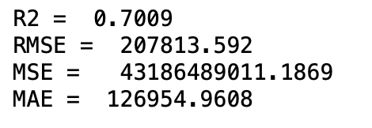
Training the model: Linear Regression
First try:
Without any adjustments:

Slide 9
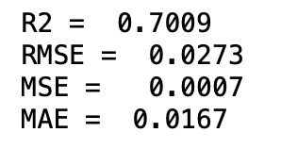
Training the model: Linear Regression
Second try (Normalisation with MinMaxScaler):

Slide 10
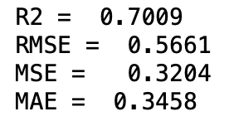
Training the model: Linear Regression
Third try (Standardisation with StandardScaler):

Slide 11
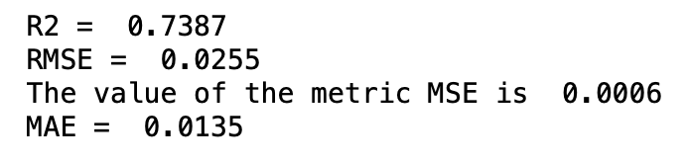
Training the model: Decision tree regressor

Slide 12
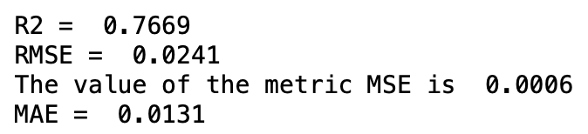
Training the model: Random Forest Regressor

Slide 13
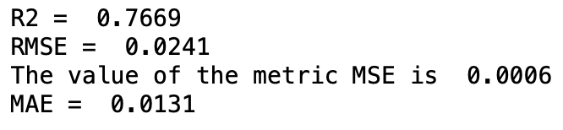
Training the model: XGBoost

Slide 14
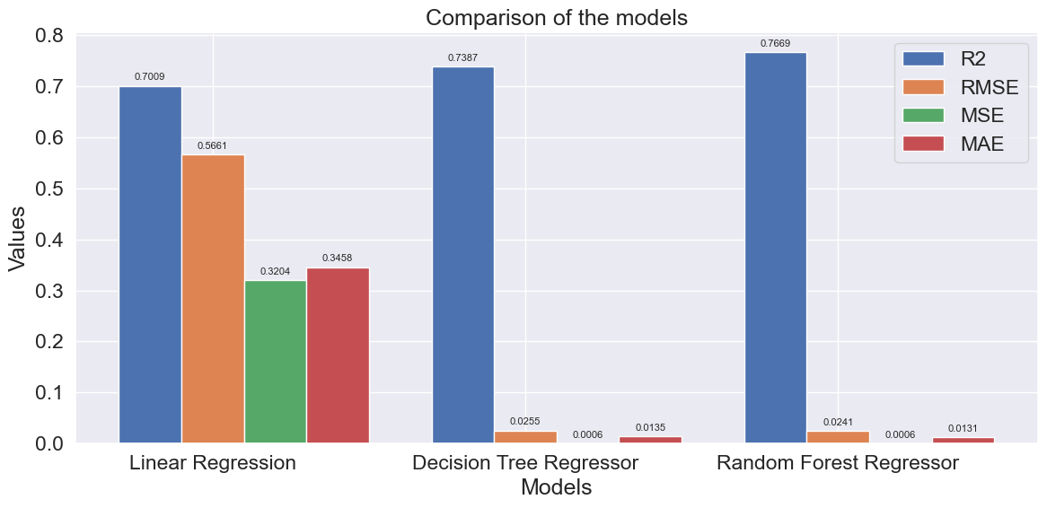
Comparison of the models

Slide 15
Conclusion
RandomForestRegressor is (so far) the preferable model to predict the house price, because it beats the other trained models in every metric.
But there are a lot of possible Improvements:
Feature Selecting, Feature Extracting, Hyperparameter Tuning, Outliers

Slide 16

Thanks for your attention!

